Slide 1

Sample Purposes Only

Slide 2

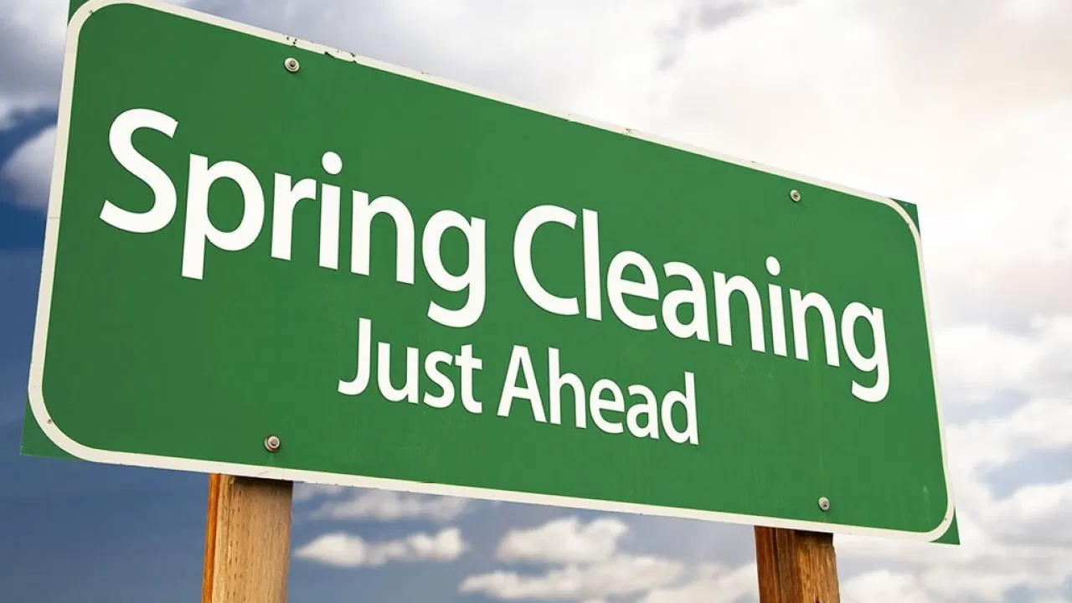
Springtime Home Maintenance
Notes:
With the days lengthening and weather warming, spring is a good time to get outdoors and tackle some larger home projects. Now that the threat of winter storms has passed, you can look for damage and make any needed repairs, as well as prep your home for summer.

Slide 3

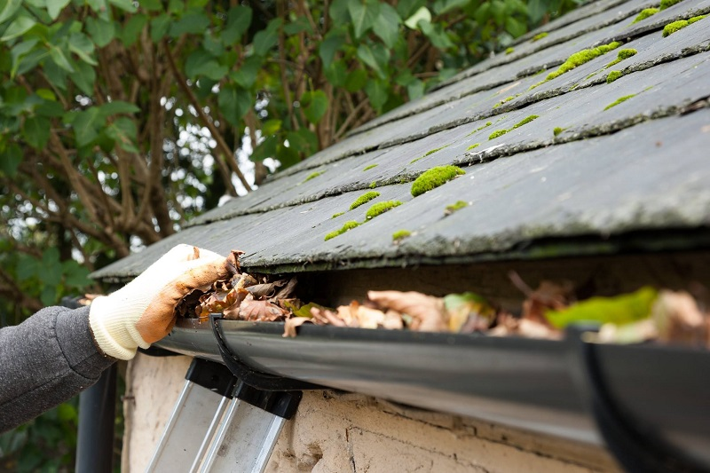
Clean Gutters & Downspouts
Notes:
After the winter has passed, it’s important to have your gutters and downspouts cleaned and repaired. ‘Clogged gutters and downspouts can cause the wood trim at the eaves to rot, and that can invite all kinds of critters into your attic space. Having your gutters and downspouts cleaned early in the season can also help prevent damage from spring rains. ‘Gutters and downspouts should be clean and running free.

Slide 4
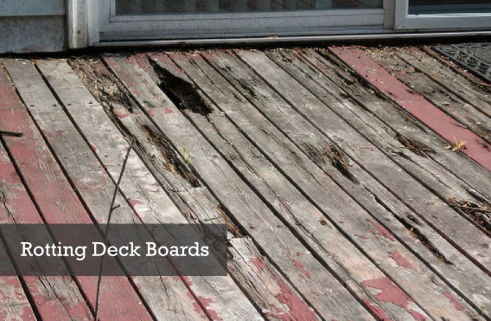
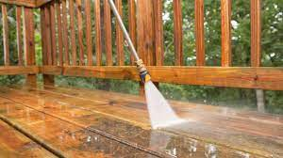

Reseal Exterior Woodwork
1
2
3
Notes:
Wood decks, fences, railings, and other outdoor wood structures will last longer and stay in better condition if they are pressure washed, stained or resealed every year or two. Take this opportunity to make any needed repairs to your woodwork as well as deterioration, dry rot, mold or decay.

Slide 5
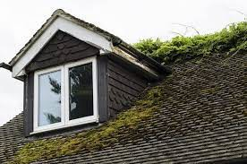
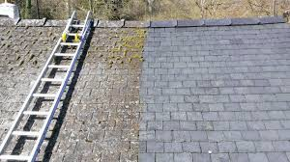
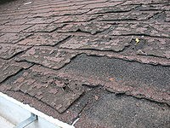
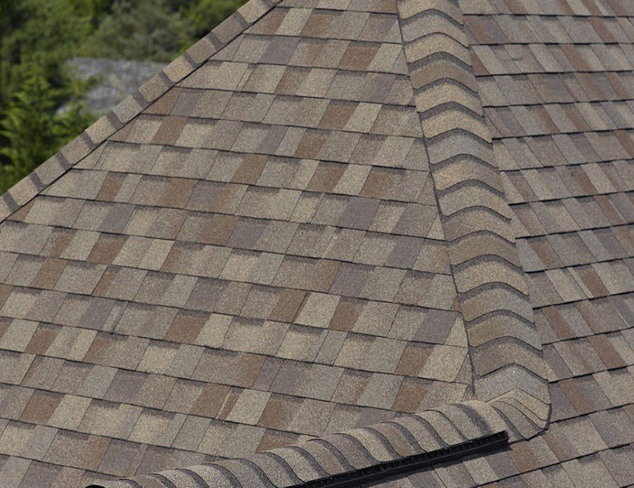
Roof Inspection
1
2
3
4
Notes:
Our Southeast Alaska Winter storms can take quite a toll on roof systems. When spring arrives, start by making a simple visual inspection of your roof. Look for missing shingles, metal flashing around chimneys, vent stacks, roof edges, metal pipes that are damaged or missing or anything that simply does not look right. If you notice anything that needs closer inspection or repair, call a roofer.

Slide 6
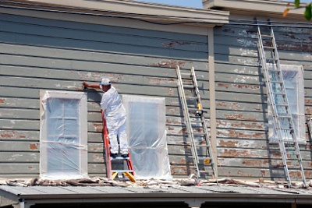
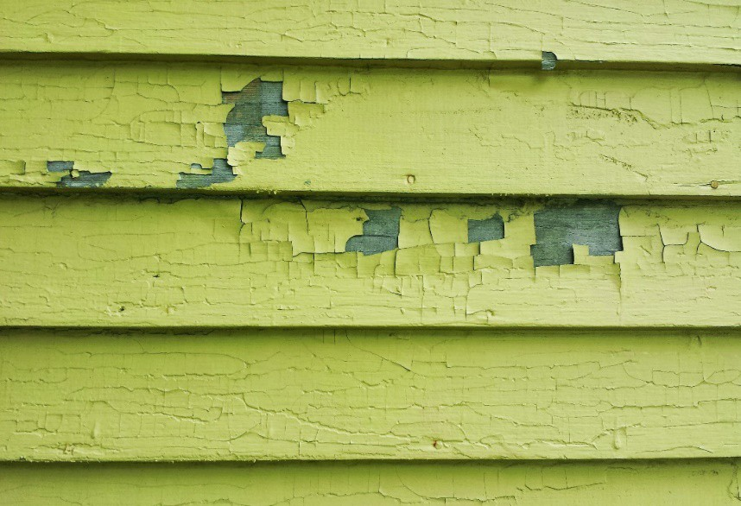
Paint exterior
Notes:
Spring is a good time to paint your home. Check painted surfaces for paint failure, peeling, bubbling, and chipping. Pre 1978 homes must be tested for LEAD base paint

Slide 7

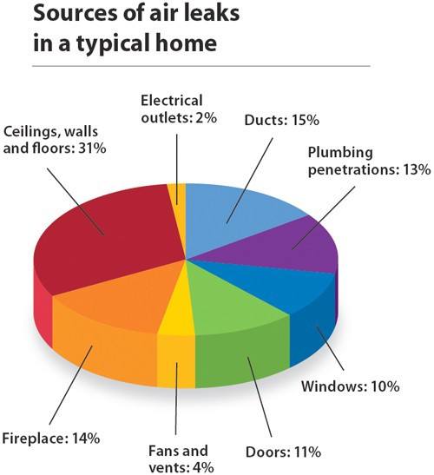
Weatherization
Notes:
Springtime is a perfect time to check exterior weatherization like caulking around doors and windows. Check the condition of your windows- Broken glass, putty, weather stripping, door sweeps etc… Check condition of your doors, hardware, and locks.

Slide 8



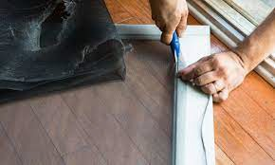
Check Screen Doors & Windows
Notes:
Screens are designed to let the breeze flow in (ventilation) and keep bugs out – but they can only do their job if they’re free from holes and tears. Before setting up your screens for the warm months ahead, be sure to carefully check each one and repair any holes or tears, no matter how small. You can find screen repair kits at most hardware and home improvement stores.

Slide 9
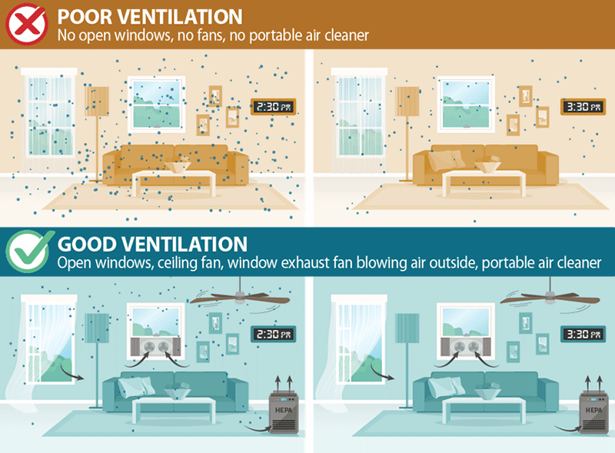
Ventilation In Your Home Is Important
Notes:
Now that it's warming up, you can let in fresh air without getting too chilly. Open all the windows to get rid of stagnant air and aerate your home. Letting pollutants in the air escape. If you’ve just painted or cleaned your kitchen floors, it’s a great time to open those windows to let any potentially toxic fumes escape. Allowing sunlight in. For some of us opening the windows is also an opportunity to open the curtains and blinds as well. Sunlight is a great mood-booster and source of vitamin D. While your windows are open, clean interior windowsills. Opening house windows for Ventilation can prevent the spread of COVID-19 in your household.

Slide 10

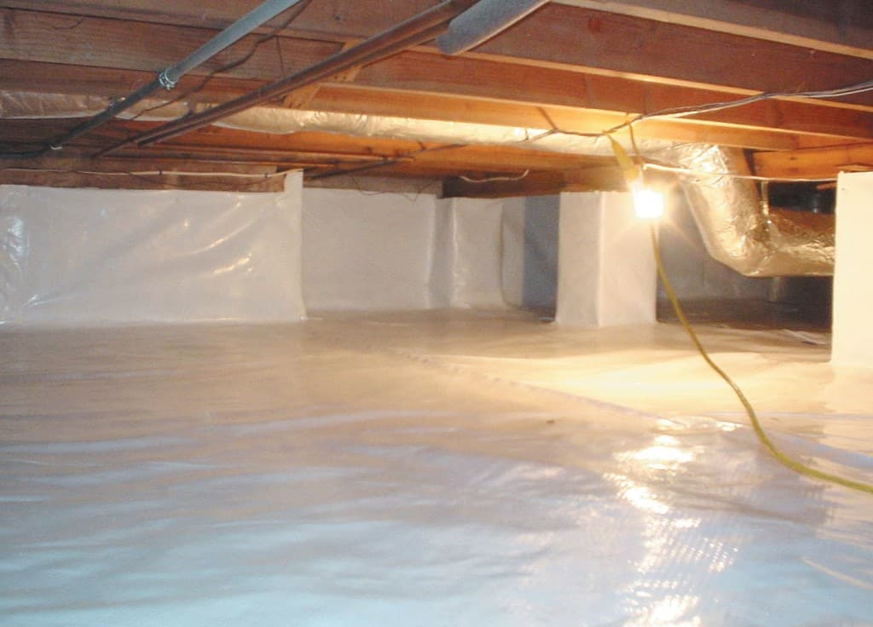
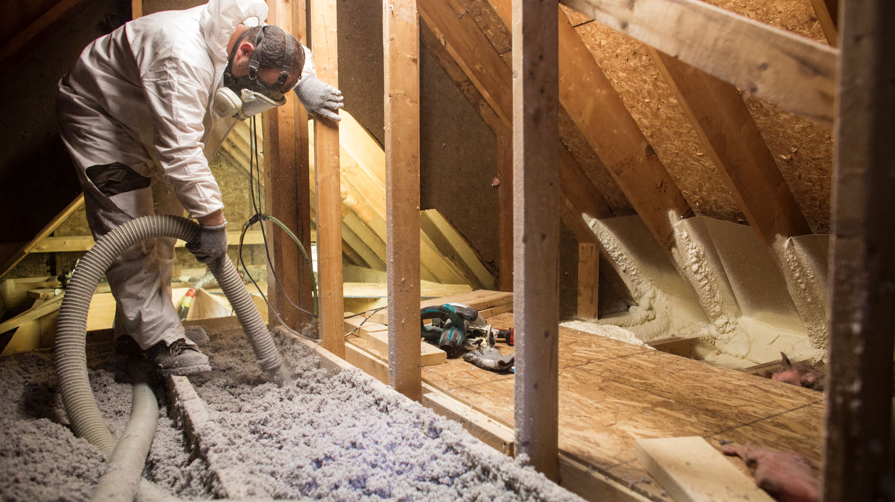
Check the Crawlspace & Attic
Attic
Crawlspace
Notes:
Head into the crawlspace and attic to look for signs of moisture that you might not have noticed. Look for leaks, water stains, mold insect infestation. Any odd smells — like mold or mildew — should be addressed immediately. Make sure your vapor mil is properly sealed (no rips or missing pieces) Open your rim vents.

Slide 11

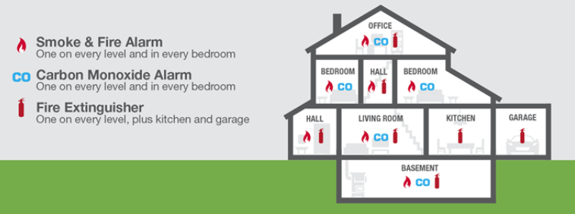
Safety First
Notes:
Safety and emergency features are easy to forget about because you do not use them often. Performing routine checks can be beneficial. Change the batteries in smoke and carbon monoxide detectors. Check fire extinguishers to make sure the needle is in the green zone. Fire extinguishers need to be service once a year by a certified technician.

Slide 12

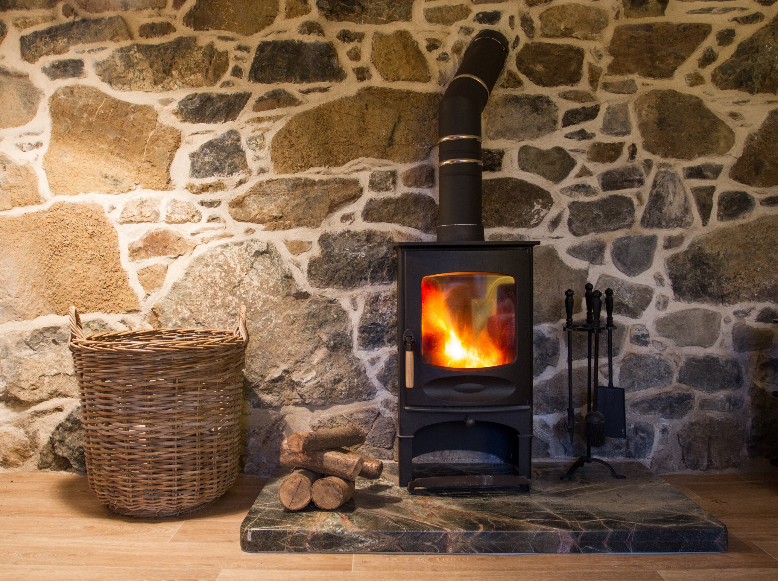
Wood Stove Maintenance
Check your wood stove to ensure it’s in good, safe working condition.
Inspect that the flue’s damper opens and closes properly.
Check gaskets and gasket rope on woodstove door, ensure it’s a tight fit.
Make sure you have a fire extinguisher close by.
Make sure you have a Carbon Monoxide and Smoke Detector installed.
Start fires with clean newspaper and dry kindling if possible
Burn hot fires during cold weather. Use smaller fires in milder weather.
Regularly remove ashes (that are not hot) from the wood stove into a metal container with a cover, and store outdoors off wooden decks.
Store your wood outdoors and stack off the ground with the top covered.
Season your firewood outdoors through the spring summer for at least 6 months before burning it.
Notes:
Springtime is a good time to inspect and clean your wood stove

Slide 13

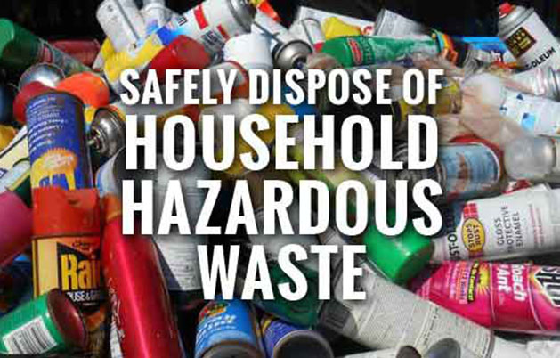
Household Hazardous Waste
Some examples of household hazardous wastes you may find around your house include:
Antifreeze
Batteries
Brake Fluid
Chlorine bleach
Lighter fluid
Kerosene
Insecticides
Flea collars and Sprays
Old Fire Extinguishers
Drain Cleaners
Contact Cement
Lye Mothball
Nail Polish Remover
Old Propane
Tank Paints (Latex and Oil)
Solvents
Spot Removers
Toilet Cleaners
Used Motor Oil
Oven Cleaners Aerosol
Spray Cans
Many communities have organized household hazardous waste collection events where these materials are collected and disposed of by local authorities free of charge. Check with your local waste management facility, fire department, or municipality office for more information.
Notes:
The definition of household hazardous waste is the discarded, unused, or leftover portion of household products containing toxic chemicals. These wastes CANNOT be disposed of in regular garbage. Any product which is labeled WARNING, CAUTION, POISONOUS, TOXIC, FLAMMABLE, CORROSIVE, REACTIVE or EXPLOSIVE should be
considered hazardous. You can't treat hazardous wastes like other kinds of garbage. For example, buried wastes can filter down through the soil and contaminate groundwater.
Plumbing systems can be damaged when corrosive chemicals are put down the drain.
Burning hazardous wastes simply distributes them over a larger area and releases them into the air. Pouring hazardous liquids on the ground can poison soil, plants and water.

Slide 14

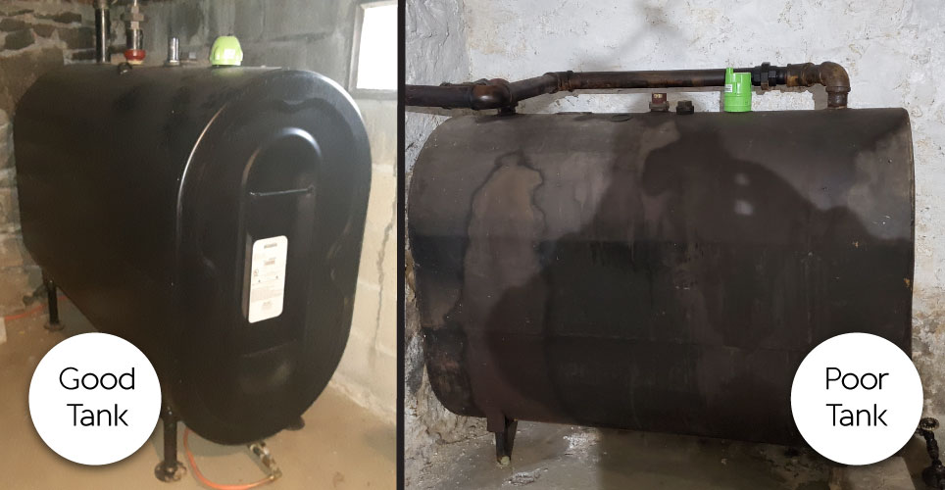
Inspect Oil Tank
Notes:
Oil Tanks have a lifetime expectancy of around ten years or so. Protect your oil tank from the elements (snow and ice). Experts recommend having your oil tank cleaned out at least every five years. Your oil company usually can do this task. Check the welded seams, vent pipe, fill pipes, legs, as well as the bottom of oil tank for any signs of leaks, corrosion, rust or damage.

Slide 15
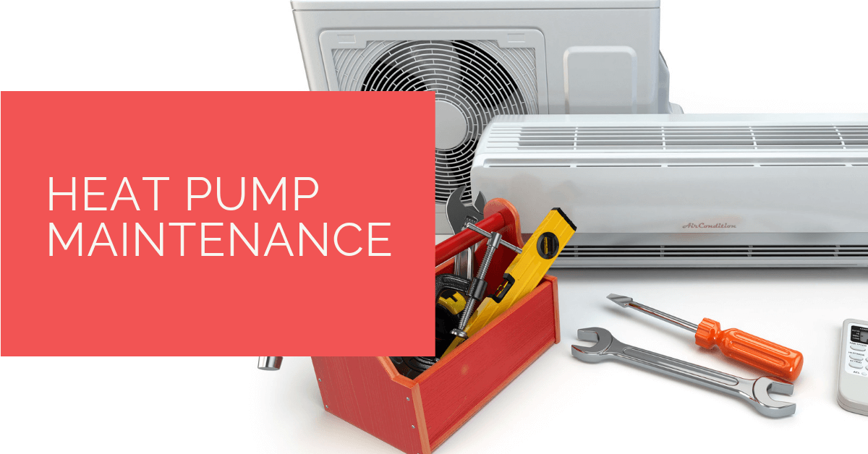
Heat Pump Maintenance
Check air-filters monthly. Clean and replace as needed. Remove filter and vacuum with furniture attachment, or spray filter with sink sprayer or garden hose. Reinstall filter back into heat pump. Close heat pump front panel.
Keep outdoor unit clear of snow, ice, and debris. This includes the top, sides, bottom, and around the heat pump.
Keep the outdoor coils clean. If they get dirty you can use a heavy-duty degreaser and hose them down. Turn the unit off first.
Flush the indoor condensate pan and drain in Spring before using the air conditioning.
Finally, it’s a good idea to have your heat pump inspected by a trained service technician once a year.

Slide 16

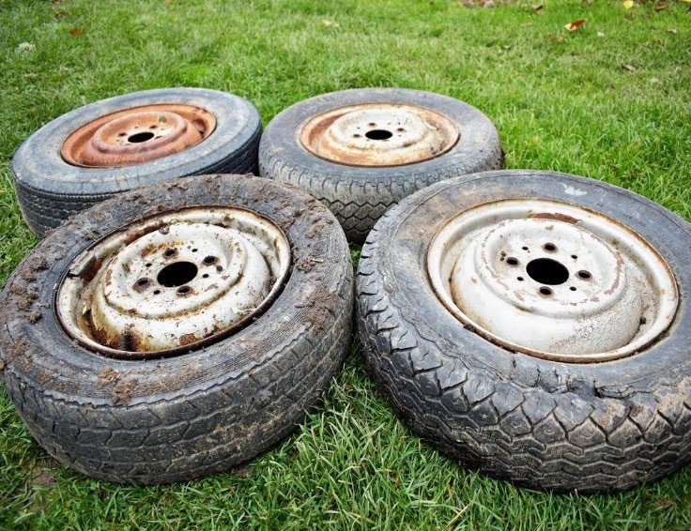
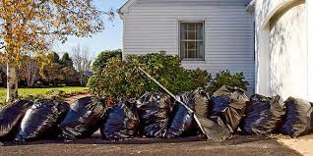
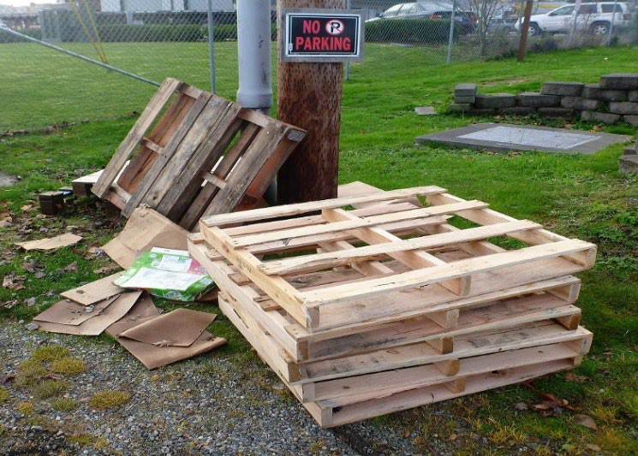
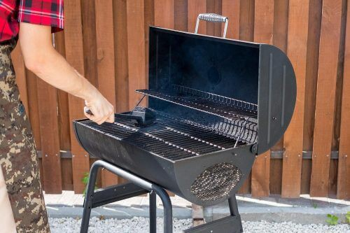
Outside Home Maintenance
Notes:
Springtime is a perfect time to. Rake leaves and weeds away from home. Clean out flower beds. Power wash concrete walkways and driveways. Inspect, and clean charcoal and propane grills. Remove old tires, pallets, broken toys, vehicles That are out of service.

